Slide 1
Washington Update AFBIS Crop Conference June 2015
Tara Smith

Slide 2
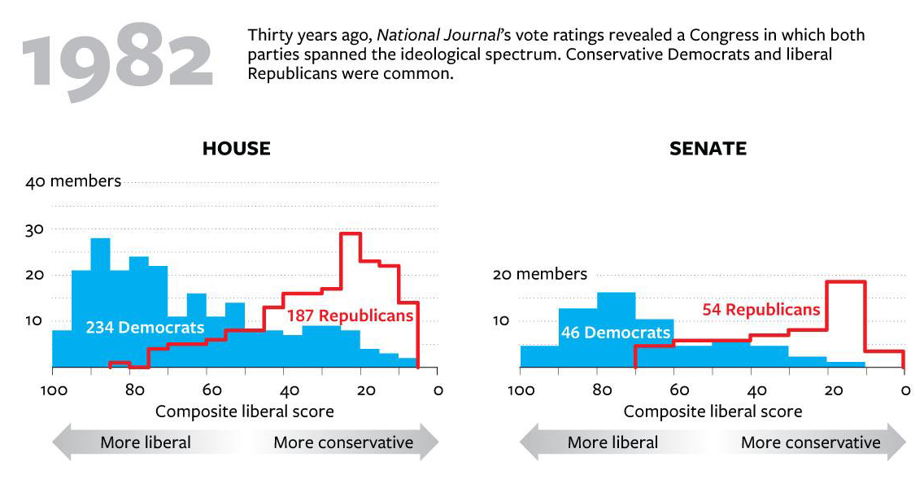
Where the Rubber Meets the Road
The Middle of Road
Source: Peter Bell at the National Journal

Slide 3
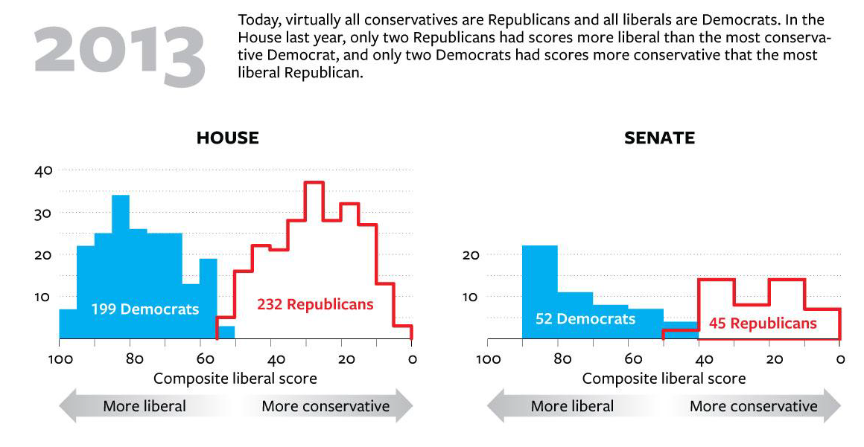
Where the Rubber Meets the Road
The Grand Canyon
Source: Peter Bell at the National Journal

Slide 4
Friends and Foes
“Crop insurance has become a bloated, taxpayer-financed subsidy to big agricultural corporations and insurance companies. Current House and Senate farm bills would expand crop insurance to farm subsidy recipients whose names remain secret while eliminating transparent farm payments. Crop insurance needs reform, not an expansion.”
“There is no valid economic argument for having taxpayers taking on so much of farmers’ risk. Congress should instead make investments that would ensure agriculture can prosper…that address the interests of both agriculture and the public.”

Slide 5
Friends and Foes
“There is no valid economic argument for having taxpayers taking on so much of farmers’ risk. Congress should instead make investments that would ensure agriculture can prosper and sustain itself in the future, focusing on issues such as renewable energy, transportation, clean water and food safety that address the interests of both agriculture and the public.”
-EWG Press Release from December 2013
“Crop insurance has become a bloated, taxpayer-financed subsidy to big agricultural corporations and insurance companies. Current House and Senate farm bills would expand crop insurance to farm subsidy recipients whose names remain secret while eliminating transparent farm payments. Crop insurance needs reform, not an expansion.”
-Heritage Foundation Issue Brief from July 2012

Slide 6
Friends and Foes
Reduce or eliminate premium assistance for revenue policies.
Require premium assistance data for individual producers be available to the public.
Not allow premium assistance for new farmland.
Apply means testing.
Reduce premium assistance to farmers.
Reduce funding for the private sector delivery system.
Require premium assistance data for individual producers be available to the public.

Slide 7
Friends and Foes
CUT $14 Billion
Reduce producer premium assistance.
Reduce the A&O cap.
Reduce the estimate rate of return for crop insurance companies.
CUT $23 Billion
Cut to be shared between the commodity title and crop insurance program.
Exact policies left up to the Agriculture Committee.

Slide 8
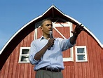
Friends and Foes
CUT $14 Billion
Reduce producer premium assistance.
Reduce the A&O cap.
Reduce the estimate rate of return for crop insurance companies.
CUT $23 Billion
Cut to be shared between the commodity title and crop insurance program.
Exact policies left up to the Agriculture Committee.
Source: 2015 Presidential and House Budget Proposals

Slide 9
Where the Rubber Meets the Road - Senate

Slide 10
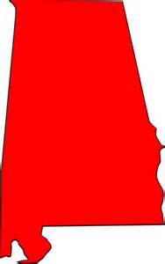
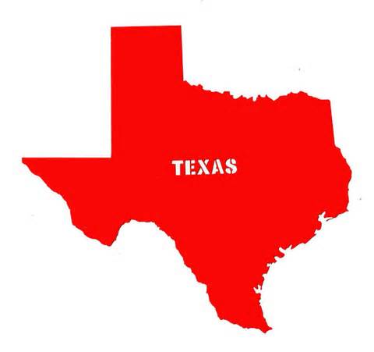
Where the Rubber Meets the Road - Senate
Yes (Against Us)
(Alabama, Texas, Indiana, Iowa)
No (With Us)
(New Hampshire, Massachusetts, Virginia, Hawaii)

Slide 11
Where the Rubber Meets the Road - House
Amendment included means testing, cap on premium assistance, a cut to private sector delivery and disclosure of private producer information

Slide 12
Where the Rubber Meets the Road - House
Amendment included means testing, cap on premium assistance, a cut to private sector delivery and disclosure of private producer information

Slide 13
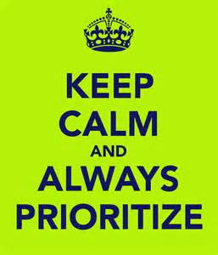
Impact on Advocacy
Focus on the Issues
Cuts to Premium Assistance
Means Testing
Cuts to the Private Sector Delivery System

Slide 14
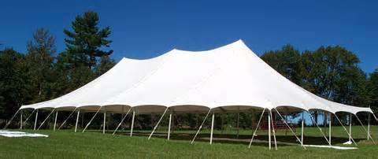
Impact on Advocacy
Focus on the Messaging
Can’t party bash
Know your audience
“Big Tent” approach
All crops and all types of policies

Slide 15
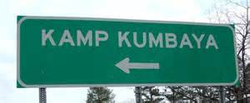
Impact on Advocacy
Focus on the Delivery
Broad coalition is key
Lenders
Input suppliers
AIPs/Reinsurers
Agents
Conservation community
All types of commodity/producer organizations

Slide 16
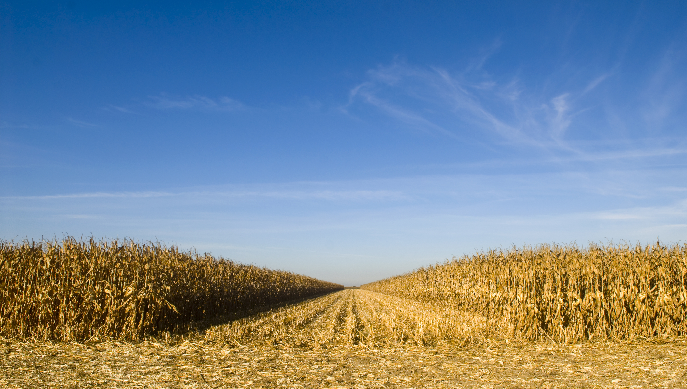
Thank You! Questions?
Tara Smith
www.cropinsurance.org

